Slide 1
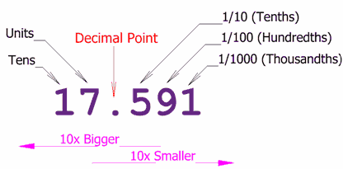
Floating Point Numbers

Slide 2
Exponential Notation
The following are equivalent
representations of 1,234
123,400.0 x 10⁻²
12,340.0 x 10⁻¹
1,234.0 x 10⁰
123.4 x 10¹
12.34 x 10²
1.234 x 10³
0.1234 x 10⁴
The representations differ in that the decimal place – the “point” -- “floats” to the left or right (with the appropriate adjustment in the exponent).

Slide 3
Parts of a Floating Point Number
Exponent
-0.9876 x 10⁻³
Sign of exponent
Sign of mantissa
Location of decimal point
Mantissa
Base

Slide 4
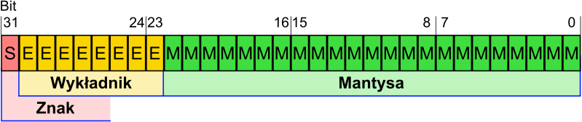
IEEE 754 Standard for representing floating point numbers
Single precision: 32 bits, consisting of...
Sign bit (1 bit)
Exponent (8 bits)
Mantissa (23 bits)
Double precision: 64 bits, consisting of…
Sign bit (1 bit)
Exponent (11 bits)
Mantissa (52 bits)
IEEE = Institute of Electrical and Electronics Engineers

Slide 5
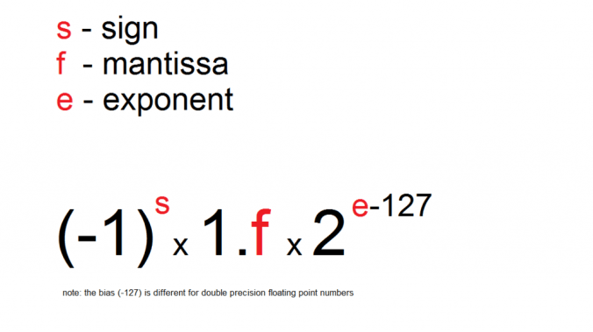
Single Precision Format (32 bits)
Mantissa (23 bits)
Exponent (8 bits)
Sign of mantissa (1 bit)

Slide 6
Normalization
The mantissa is normalized
Has an implied decimal place on left
Has an implied “1” on left of the decimal place
e.g.,
Mantissa →
Represents…
10100000000000000000000
1.101₂ = 1.625₁₀

Slide 7
Excess Notation
To include +ve & –ve exponents, “excess” notation is used
Single precision: excess 127 (1023 for double precision)
The value of the exponent stored is larger than the actual exponent, e.g., excess 127,
Exponent → 127
Represents…
10000111
135 – 127 = 8
+ve - positive
Notes:
Excess - nadmiar

Slide 8
Example
1.
Single precision
0 10000010 11000000000000000000000
1.11₂
130 – 127 = 3
0 = positive mantissa
+1.11₂ x 2³ = 1110.0₂ = 14.0₁₀

Slide 9
Hexadecimal
It is convenient and common to represent the original floating point number in hexadecimal
The preceding example…
0 10000010 11000000000000000000000
4
1
6
0
0
0
0
0

Slide 10
Converting from Floating Point
E.g.,
what decimal value is represented by the following 32-bit floating point number?
C17B0000₁₆

Slide 11
Step 1
Express in binary and find S, E, and M
C17B0000₁₆ =
1 10000010 11110110000000000000000₂
S
E
M
1 = negative
0 = positive

Slide 12
Step 2
Find “real” exponent, n
n = E – 127
= 10000010₂ – 127
= 130 – 127
= 3

Slide 13
1.
Step 3
Put S, M, and n together to form binary result
(Don’t forget the implied “1.” on the left of the mantissa.)
-1.1111011₂ x 2^{n} =
-1.1111011₂ x 2³ =
-1111.1011₂

Slide 14
Step 4
Express result in decimal
-1111.1011₂
-15
2⁻¹ = 0.5
2⁻³ = 0.125
2⁻⁴ = 0.0625
0.6875
Answer: -15.6875

Slide 15
Converting to Floating Point
E.g.,
Express 36.5625₁₀ as a 32-bit floating point number (in hexadecimal)

Slide 16
Step 1
Express original value in binary
36.5625₁₀ =
100100.1001₂

Slide 17
Step 2
Normalize
100100.1001₂ =
1.001001001₂ x 2⁵

Slide 18
Step 3
Determine S, E, and M
+1.001001001₂ x 2⁵
n
E = n + 127
= 5 + 127
= 132
= 10000100₂
S
M
S = 0 (because the value is positive)

Slide 19
Step 4
Put S, E, and M together to form 32-bit binary result
0 10000100 00100100100000000000000₂
S
E
M

Slide 20
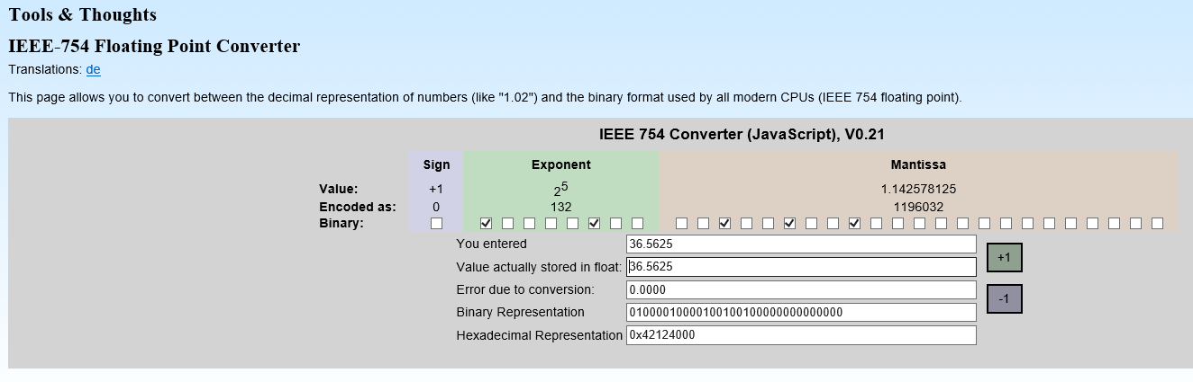
Step 5 - Express in hexadecimal
0 10000100 00100100100000000000000₂ =
0100 0010 0001 0010 0100 0000 0000 0000₂ =
4 2 1 2 4 0 0 0₁₆
Answer: 42124000₁₆

Slide 21
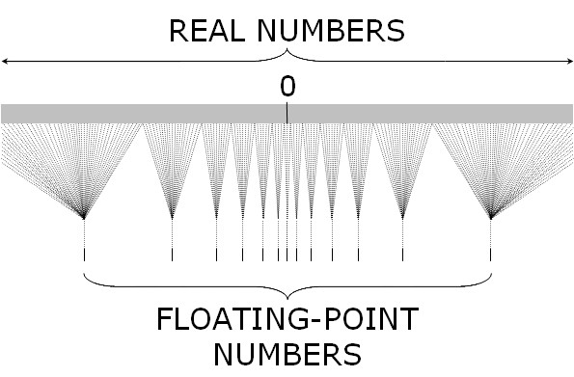
(A + B) + C ≠ A + (B + C)

Slide 22


